Slide 1

E
H
D
U
C
S
L
T
A
U
F
B
L
ß

Slide 2
D
T
S
H
E
U
C
F
U
ß
B
A
L
L
Group member
John Justin Jack

Slide 3
CONTENT
Background information
achievement
New technology that promises to improve inflammation treatment
Adjuvant therapy
Dietetic therapy

Slide 4
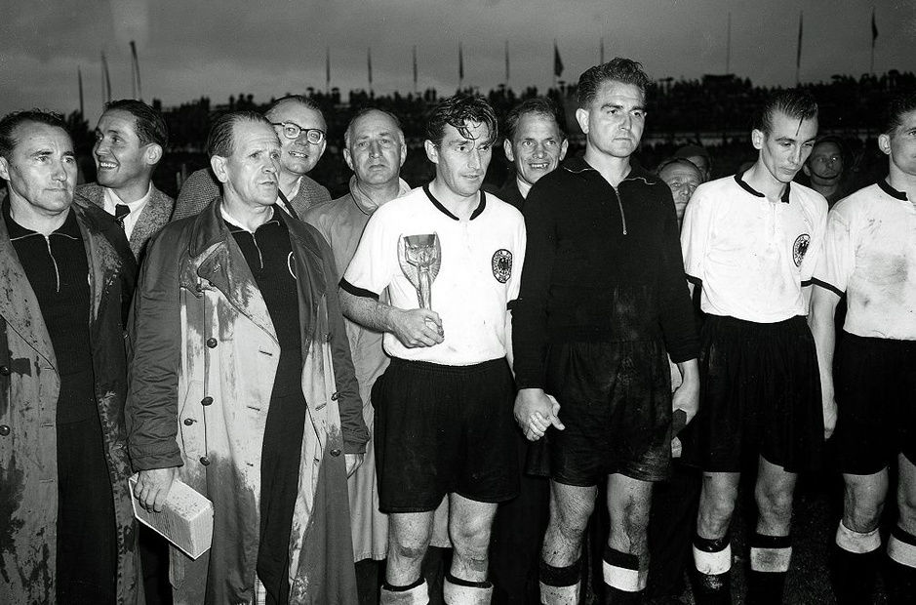
1
Background information

Slide 5




Background information
1.Das Wunder Von Bern
2.Connection with German football

Slide 6


2

Slide 7





Reputation

Slide 8



Slide 9


